Slide 1
File Handling

Slide 2
Why File Handling is Required?
File Handling is an integral part of any programming language as file handling enables us to store the output of any particular program in a file and allows us to perform certain operations on it.
In simple words, file handling means reading and writing data to a file.

Slide 3
This File Class is inside the java.io package. The File class can be used by creating an object of the class and then specifying the name of the file.

Slide 4
In Java, the concept Stream is used in order to perform I/O operations on a file. So at first, let us get acquainted with a concept of i/o operation and Stream in Java.

Slide 5
Java I/O
Java uses the concept of a stream to make I/O operation fast. The java.io package contains all the classes required for input and output operations.
We can perform file handling in Java by Java I/O API.

Slide 6
Stream
A stream is a sequence of data. In Java, a stream is composed of bytes. It's called a stream because it is like a stream of water that continues to flow.
Java brings various Streams with its I/O package that helps the user to perform all the input-output operations. These streams support all the types of objects, data-types, characters, files etc to fully execute the I/O operations.

Slide 7
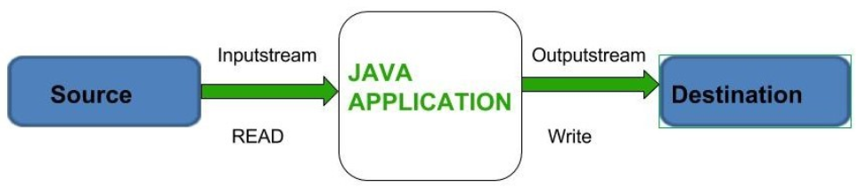

Slide 8
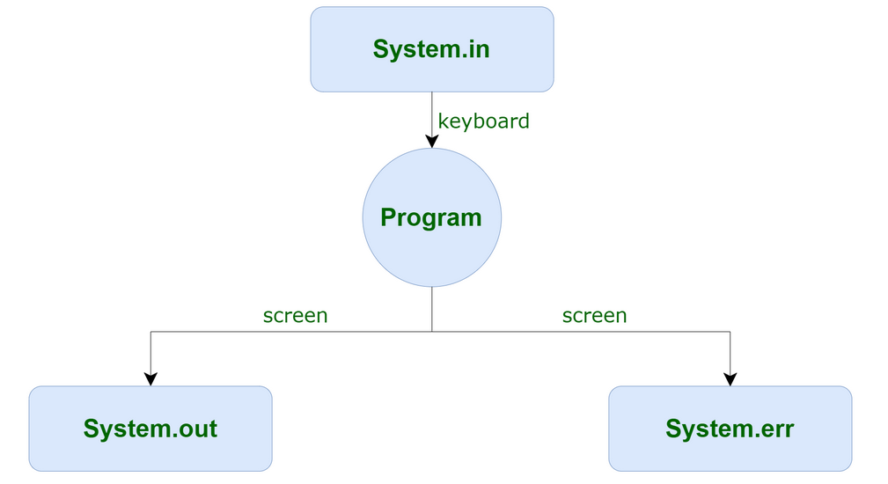
3 standard or default streams that Java has to provide which are also most common in use:

Slide 9
System.err
System.err is a PrintStream. System.err works like System.out except it is normally only used to output error texts. Some programs (like Eclipse) will show the output to System.err in red text, to make it more obvious that it is error text.

Slide 10
eg-
System.out.println("What is your name?");
Scanner scanner = new Scanner(System.in);
String name = scanner.nextLine();
System.out.println(name + " is a nice name!");
System.err.println("File opening failed:");

Slide 11
Stream
A series of data is referred to as a stream. In Java, Stream is classified into two types, i.e., Byte Stream and Character Stream.

Slide 12
Byte Stream
Byte Stream is mainly involved with byte data. A file handling process with a byte stream is a process in which an input is provided and executed with the byte data.
Though it has many classes, the FileInputStream and the FileOutputStream are the most popular ones. The FileInputStream is used to read from the source and FileOutputStream is used to write to the destination.
Character Stream
Character Stream is mainly involved with character data. A file handling process with a character stream is a process in which an input is provided and executed with the character data.
Though it has many classes, the FileReader and the FileWriter are the most popular ones. FileReader and FileWriter are character streams used to read from the source and write to the destination respectively.

Slide 13
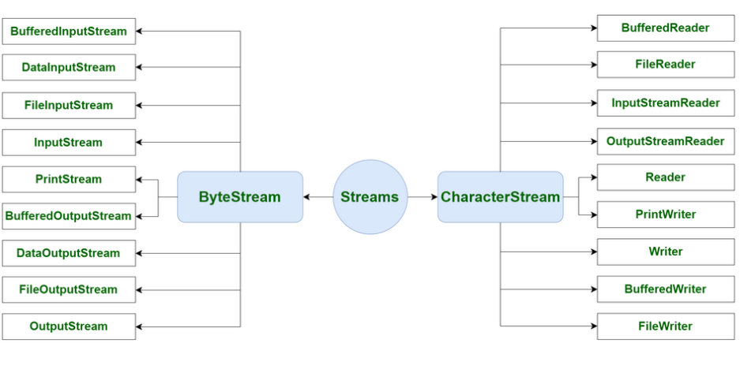

Slide 14
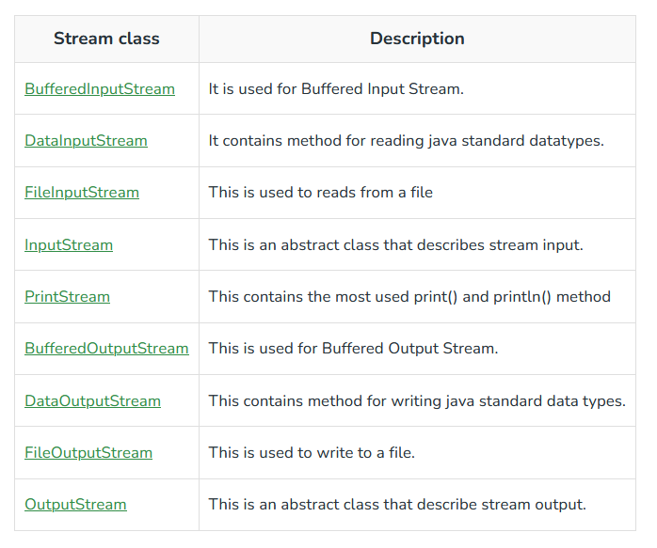
Byte Stream class

Slide 15
eg-
// Java Program illustrating the
// Byte Stream to copy
// contents of one file to another file.
import java.io.*;
public class BStream {
public static void main(
String[] args) throws IOException
{
FileInputStream sourceStream = null;
FileOutputStream targetStream = null;
try {
sourceStream = new FileInputStream("sorcefile.txt");
targetStream
= new FileOutputStream("targetfile.txt");
// Reading source file and writing
// content to target file byte by byte
int temp;
while ((
temp = sourceStream.read())
!= -1)
targetStream.write((byte)temp);
}
finally {
if (sourceStream != null)
sourceStream.close();
if (targetStream != null)
targetStream.close();
}
}
}

Slide 16
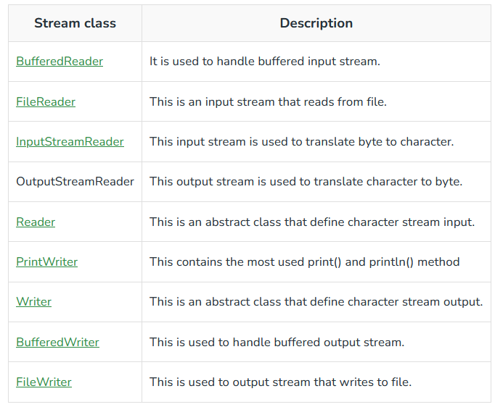
Character Stream class

Slide 17
eg-
// Java Program illustrating that
// we can read a file in a human-readable
// format using FileReader
// Accessing FileReader, FileWriter,
// and IOException
import java.io.*;
public class Main{
public static void main(
String[] args) throws IOException
{
FileReader sourceStream = null;
try {
sourceStream
= new FileReader("test.txt");
// Reading sourcefile and
// writing content to target file
// character by character.
int temp;
while ((
temp = sourceStream.read())
!= -1)
System.out.println((char)temp);
}
finally {
// Closing stream as no longer in use
if (sourceStream != null)
sourceStream.close();
}
}
}

Slide 18
When to use Character Stream over Byte Stream?
In Java, characters are stored using Unicode conventions. Character stream is useful when we want to process text files. These text files can be processed character by character. Character size is typically 16 bits.
When to use Byte Stream over Character Stream?
Byte oriented reads byte by byte. A byte stream is suitable for processing raw data like binary files.

Slide 19
FileOutputStream Class
Java FileOutputStream is an output stream used for writing data to a file.
If you have to write primitive values into a file, use FileOutputStream class. You can write byte-oriented as well as character-oriented data through FileOutputStream class. But, for character-oriented data, it is preferred to use FileWriter than FileOutputStream.

Slide 20
import java.io.FileOutputStream;
public class FileOutputStreamExample {
public static void main(String args[]){
try{
FileOutputStream fout=new FileOutputStream("D:\\testout.txt");
String s="Welcome to javaTpoint.";
byte b[]=s.getBytes();//converting string into byte array
fout.write(b);
fout.close();
System.out.println("success...");
}catch(Exception e){System.out.println(e);}
}
}

Slide 21
FileInputStream class
Java FileInputStream class obtains input bytes from a file. It is used for reading byte-oriented data (streams of raw bytes) such as image data, audio, video etc. You can also read character-stream data. But, for reading streams of characters, it is recommended to use FileReader class.

Slide 22
import java.io.FileInputStream;
public class DataStreamExample {
public static void main(String args[]){
try{
FileInputStream fin=new FileInputStream("D:\\testout.txt");
int i=0;
while((i=fin.read())!=-1){
System.out.print((char)i);
}
fin.close();
}catch(Exception e){System.out.println(e);}
}
}

Slide 23
BufferedOutputStream Class
Java BufferedOutputStream class is used for buffering an output stream. It internally uses buffer to store data. It adds more efficiency than to write data directly into a stream. So, it makes the performance fast.
For adding the buffer in an OutputStream, use the BufferedOutputStream class

Slide 24
*The flush() flushes the data of one stream and send it into another. It is required if you have connected the one stream with another.*
import java.io.*;
public class BufferedOutputStreamExample{
public static void main(String args[])throws Exception{
FileOutputStream fout=new FileOutputStream("D:\\testout.txt");
BufferedOutputStream bout=new BufferedOutputStream(fout);
String s="Welcome to javaTpoint.";
byte b[]=s.getBytes();
bout.write(b);
bout.flush();
bout.close();
fout.close();
System.out.println("success");
}
}

Slide 25
BufferedInputStream Class
Java BufferedInputStream class is used to read information from stream. It internally uses buffer mechanism to make the performance fast.
The important points about BufferedInputStream are:
When the bytes from the stream are skipped or read, the internal buffer automatically refilled from the contained input stream, many bytes at a time.
When a BufferedInputStream is created, an internal buffer array is created.

Slide 26
SequenceInputStream Class
Java SequenceInputStream class is used to read data from multiple streams. It reads data sequentially (one by one).
Eg-
import java.io.*;
class InputStreamExample {
public static void main(String args[])throws Exception{
FileInputStream input1=new FileInputStream("D:\\testin.txt");
FileInputStream input2=new FileInputStream("D:\\testout.txt");
SequenceInputStream inst=new SequenceInputStream(input1, input2);
int j;
while((j=inst.read())!=-1){
System.out.print((char)j);
}
inst.close();
input1.close();
input2.close();
}
}

Slide 27
Example that reads the data from two files and writes into another file
import java.io.*;
class Input1{
public static void main(String args[])throws Exception{
FileInputStream fin1=new FileInputStream("D:\\testin1.txt");
FileInputStream fin2=new FileInputStream("D:\\testin2.txt");
FileOutputStream fout=new FileOutputStream("D:\\testout.txt");
SequenceInputStream sis=new SequenceInputStream(fin1,fin2);
int i;
while((i=sis.read())!=-1)
{
fout.write(i);
}
sis.close();
fout.close();
fin1.close();
fin2.close();
System.out.println("Success..");
}
}

Slide 28
ByteArrayOutputStream Class
Java ByteArrayOutputStream class is used to write common data into multiple files. In this stream, the data is written into a byte array which can be written to multiple streams later.
The ByteArrayOutputStream holds a copy of data and forwards it to multiple streams.
The buffer of ByteArrayOutputStream automatically grows according to data.

Slide 29
import java.io.*;
public class DataStreamExample {
public static void main(String args[])throws Exception{
FileOutputStream fout1=new FileOutputStream("D:\\f1.txt");
FileOutputStream fout2=new FileOutputStream("D:\\f2.txt");
ByteArrayOutputStream bout=new ByteArrayOutputStream();
bout.write(65);
bout.writeTo(fout1);
bout.writeTo(fout2);
bout.flush();
bout.close();//has no effect
System.out.println("Success...");
}
}

Slide 30
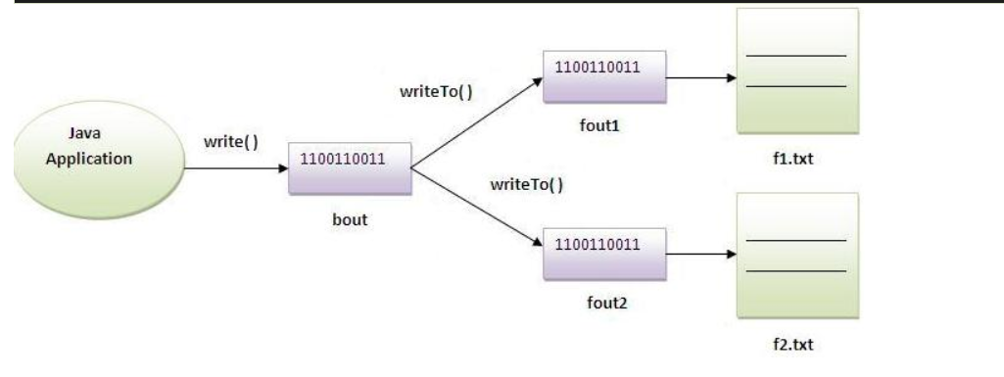
Explanation:

Slide 31
ByteArrayInputStream Class
The ByteArrayInputStream is composed of two words: ByteArray and InputStream. As the name suggests, it can be used to read byte array as input stream.
Java ByteArrayInputStream class contains an internal buffer which is used to read byte array as stream. In this stream, the data is read from a byte array.
The buffer of ByteArrayInputStream automatically grows according to data.

Slide 32
eg-
import java.io.*;
public class ReadExample {
public static void main(String[] args) throws IOException {
byte[] buf = { 35, 36, 37, 38 };
// Create the new byte array input stream
ByteArrayInputStream byt = new ByteArrayInputStream(buf);
int k = 0;
while ((k = byt.read()) != -1) {
//Conversion of a byte into character
char ch = (char) k;
System.out.println("ASCII value of Character is:" + k + "; Special character is: " + ch);
}
}
}

Slide 33
Java Writer class
It is an abstract class for writing to character streams. The methods that a subclass must implement are write(char[], int, int), flush(), and close(). Most subclasses will override some of the methods defined here to provide higher efficiency, functionality or both.

Slide 34
public class WriterExample {
public static void main(String[] args) {
try {
Writer w = new FileWriter("output.txt");
String content = "I love my country";
w.write(content);
w.close();
System.out.println("Done");
} catch (IOException e) {
e.printStackTrace();
}
}
}

Slide 35
Reader class
Java Reader is an abstract class for reading character streams. The only methods that a subclass must implement are read(char[], int, int) and close(). Most subclasses, however, will override some of the methods to provide higher efficiency, additional functionality, or both.

Slide 36
import java.io.*;
public class ReaderExample {
public static void main(String[] args) {
try {
Reader reader = new FileReader("file.txt");
int data = reader.read();
while (data != -1) {
System.out.print((char) data);
data = reader.read();
}
reader.close();
} catch (Exception ex) {
System.out.println(ex.getMessage());
}
}
}

Slide 37
FileWriter Class
Java FileWriter class is used to write character-oriented data to a file. It is character-oriented class which is used for file handling in java.
Unlike FileOutputStream class, you don't need to convert string into byte array because it provides method to write string directly.

Slide 38
import java.io.FileWriter;
public class FileWriterExample {
public static void main(String args[]){
try{
FileWriter fw=new FileWriter("D:\\testout.txt");
fw.write("Welcome to javaTpoint.");
fw.close();
}catch(Exception e){System.out.println(e);}
System.out.println("Success...");
}
}

Slide 39
FileReader Class
Java FileReader class is used to read data from the file. It returns data in byte format like FileInputStream class.
It is character-oriented class which is used for file handling in java.

Slide 40
import java.io.FileReader;
public class FileReaderExample {
public static void main(String args[])throws Exception{
FileReader fr=new FileReader("D:\\testout.txt");
int i;
while((i=fr.read())!=-1)
System.out.print((char)i);
fr.close();
}
}

Slide 41
Owing to the fact that you know what a stream is, let’s polish up File Handling in Java by further understanding the various methods that are useful for performing operations on the files like creating, reading, and writing files.

Slide 42
File operations in Java
The following are the several operations that can be performed on a file in Java :
Create a File
Read from a File
Write to a File
Delete a File

Slide 43
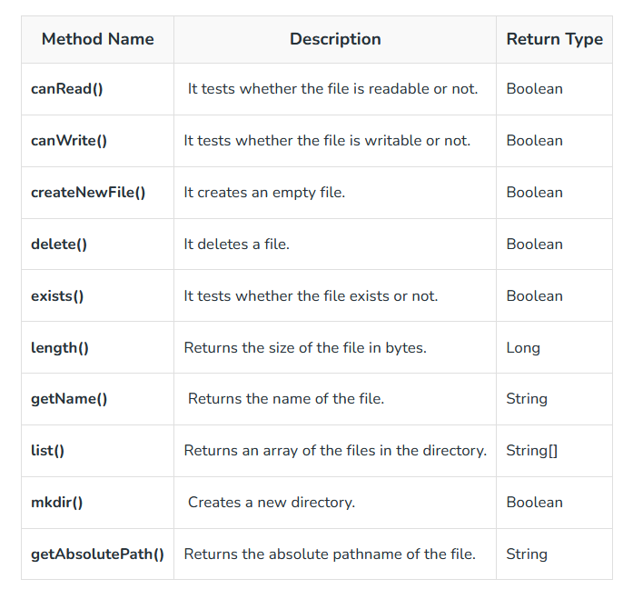
List of function inside File class:

Slide 44
1. Create a File
In order to create a file in Java, you can use the createNewFile() method.
If the file is successfully created, it will return a Boolean value true and false if the file already exists.

Slide 45
// Import the File class
import java.io.File;
// Import the IOException class to handle errors
import java.io.IOException;
public class GFG {
public static void main(String[] args)
{
try {
File Obj = new File("myfile.txt");
if (Obj.createNewFile()) {
System.out.println("File created: "
+ Obj.getName());
}
else {
System.out.println("File already exists.");
}
}
catch (IOException e) {
System.out.println("An error has occurred.");
e.printStackTrace();
}
}
}

Slide 46
Note to specify the directory use
File myObj = new File("C:\\Users\\MyName\\filename.txt");

Slide 47
2. Read from a File: We will use the Scanner class in order to read contents from a file.
public class ReadFile {
public static void main(String[] args) {
try {
File myObj = new File("filename.txt");
Scanner myReader = new Scanner(myObj);
while (myReader.hasNextLine()) {
String data = myReader.nextLine();
System.out.println(data);
}
myReader.close();
} catch (FileNotFoundException e) {
System.out.println("An error occurred.");
e.printStackTrace();
}
}
}

Slide 48
If we need file details
public class GetFileInfo {
public static void main(String[] args) {
File myObj = new File("filename.txt");
if (myObj.exists()) {
System.out.println("File name: " + myObj.getName());
System.out.println("Absolute path: " + myObj.getAbsolutePath());
System.out.println("Writeable: " + myObj.canWrite());
System.out.println("Readable " + myObj.canRead());
System.out.println("File size in bytes " + myObj.length());
} else {
System.out.println("The file does not exist.");
}
}
}

Slide 49
Note: There are many available classes in the Java API that can be used to read and write files in Java: FileReader, BufferedReader, Files, Scanner, FileInputStream, FileWriter, BufferedWriter, FileOutputStream, etc. Which one to use depends on the Java version you're working with and whether you need to read bytes or characters, and the size of the file/lines etc.

Slide 50
Delete a File
To delete a file in Java, use the delete()
public class DeleteFile {
public static void main(String[] args) {
File myObj = new File("filename.txt");
if (myObj.delete()) {
System.out.println("Deleted the file: " + myObj.getName());
} else {
System.out.println("Failed to delete the file.");
}
}
}

Slide 51
Delete a Folder
You can also delete a folder. However, it must be empty:
public class DeleteFolder {
public static void main(String[] args) {
File myObj = new File("C:\\Users\\MyName\\Test");
if (myObj.delete()) {
System.out.println("Deleted the folder: " + myObj.getName());
} else {
System.out.println("Failed to delete the folder.");
}
}
}

Slide 52
What about java objects?
Serialization is usually used When the need arises to send your data over network or stored in files. By data I mean objects and not text.
Now the problem is your Network infrastructure and your Hard disk are hardware components that understand bits and bytes but not JAVA objects.
Serialization is the translation of your Java object's values/states to bytes to send it over network or save it.

Slide 53
Serialization and Deserialization
Serialization is a mechanism of converting the state of an object into a byte stream.
Deserialization is the reverse process where the byte stream is used to recreate the actual Java object in memory.

Slide 54
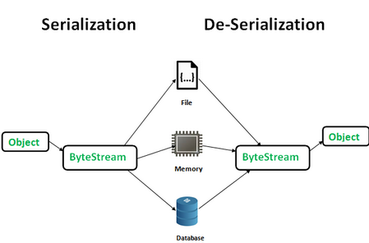

Slide 55
The byte stream created is platform independent. So, the object serialized on one platform can be deserialized on a different platform. To make a Java object serializable we implement the java.io.Serializable interface. The ObjectOutputStream class contains writeObject() method for serializing an Object.

Slide 56
eg-
package April21;
import java.io.FileInputStream;
import java.io.FileOutputStream;
import java.io.IOException;
import java.io.ObjectInputStream;
import java.io.ObjectOutputStream;
import java.io.Serializable;
class Person implements Serializable {
/**
*
*/
private static final long serialVersionUID = 1L;
private String name;
private int age;
public Person(String name, int age) {
this.name = name;
this.age = age;
}
public void setName(String name) {
this.name = name;
}
public void setAge(int age) {
this.age = age;
}
public String toString() {
return "Name: " + name + ", Age: " + age;
}
}
public class SerialisationExample {
public static void main(String[] args) {
Person person = new Person("John", 88);
System.out.println("Original Object: " + person);
try {
FileOutputStream fos = new FileOutputStream("person.ser");
ObjectOutputStream oos = new ObjectOutputStream(fos);
oos.writeObject(person);
oos.close();
fos.close();
System.out.println("Person object serialized successfully");
} catch (IOException e) {
e.printStackTrace();
}
person.setName("Jane");
person.setAge(25);
System.out.println("Modified Object: " + person);
try {
FileInputStream fis = new FileInputStream("person.ser");
ObjectInputStream ois = new ObjectInputStream(fis);
Person deserializedPerson = (Person) ois.readObject();
ois.close();
fis.close();
System.out.println("Person object deserialized successfully");
System.out.println("Deserialized Object: " + deserializedPerson);
} catch (IOException | ClassNotFoundException e) {
e.printStackTrace();
}
}
}

Slide 57
Externalisation
We are required to implement the java.io.Externalizable interface to control reading and writing during the serialization and deserialization. The methods readExternal() and writeExternal() are the parts of Externalizable interface.
The Externalizable interfaces' objects are implemented using the readExternal() method. It restores objects by calling the methods of DataInput for primitive types. It can call readObject for objects, strings, and arrays data type.

Slide 58
import java.io.*;
class Person implements Externalizable {
private String name;
private int age;
public Person() {
// Required default constructor for Externalizable interface
}
public Person(String name, int age) {
this.name = name;
this.age = age;
}
public void setName(String name) {
this.name = name;
}
public void setAge(int age) {
this.age = age;
}
public String toString() {
return "Name: " + name + ", Age: " + age;
}
@Override
public void writeExternal(ObjectOutput out) throws IOException {
out.writeUTF(name);
out.writeInt(age);
}
@Override
public void readExternal(ObjectInput in) throws IOException, ClassNotFoundException {
name = in.readUTF();
age = in.readInt();
}
}
public class ExternalizationDemo {
public static void main(String[] args) {
Person person = new Person("John", 30);
System.out.println("Original Object: " + person);
try {
FileOutputStream fos = new FileOutputStream("person.ser");
ObjectOutputStream oos = new ObjectOutputStream(fos);
person.writeExternal(oos);
oos.close();
fos.close();
System.out.println("Person object externalized successfully");
} catch (IOException e) {
e.printStackTrace();
}
Person modifiedPerson = new Person("Jane", 25);
System.out.println("Modified Object: " + modifiedPerson);
try {
FileInputStream fis = new FileInputStream("person.ser");
ObjectInputStream ois = new ObjectInputStream(fis);
Person deserializedPerson = new Person();
deserializedPerson.readExternal(ois);
ois.close();
fis.close();
System.out.println("Person object deserialized successfully");
System.out.println("Deserialized Object: " + deserializedPerson);
} catch (IOException | ClassNotFoundException e) {
e.printStackTrace();
}
}
}

Slide 59
transient keyword
transient is a variables modifier used in serialization. At the time of serialization, if we don’t want to save value of a particular variable in a file, then we use transient keyword. When JVM comes across transient keyword, it ignores original value of the variable and save default value of that variable data type.
transient keyword plays an important role to meet security constraints. There are various real-life examples where we don’t want to save private data in file. Another use of transient keyword is not to serialize the variable whose value can be calculated/derived using other serialized objects or system such as age of a person, current date, etc. Practically we serialized only those fields which represent a state of instance, after all serialization is all about to save state of an object to a file. It is good habit to use transient keyword with private confidential fields of a class during serialization.

Slide 60
// Java program to demonstrate transient keyword
// Filename Test.java
import java.io.*;
class Test implements Serializable
{
// Normal variables
int i = 10, j = 20;
// Transient variables
transient int k = 30;
// Use of transient has no impact here
transient static int l = 40;
transient final int m = 50;
public static void main(String[] args) throws Exception
{
Test input = new Test();
// serialization
FileOutputStream fos = new FileOutputStream("abc.txt");
ObjectOutputStream oos = new ObjectOutputStream(fos);
oos.writeObject(input);
// de-serialization
FileInputStream fis = new FileInputStream("abc.txt");
ObjectInputStream ois = new ObjectInputStream(fis);
Test output = (Test)ois.readObject();
System.out.println("i = " + output.i);
System.out.println("j = " + output.j);
System.out.println("k = " + output.k);
System.out.println("l = " + output.l);
System.out.println("m = " + output.m);
}
}

